Slide 1
Analyzing Loan Status using Regression, KNN, and Random Forest
Classification
Presented by Josh Meldrum

Slide 2
Agenda
1. Introduction
2. Project Walkthrough
3. Overall Insights
4. Detailed Insights
5. Summary

Slide 3
Introduction
The purpose of this project is to analyze loan status based on a number of independent variables.
The goal is to identify strategies for a credit union to aid in making strong business decisions.

Slide 4
Steps Taken to Build Prediction Models
1
2
3
4
5
1
8
6
1
7
1
Read Data into Python
Checked Columns and Data Types
Data Cleaning
Made dataframes to address null values
Dropped columns with many missing values
Performed correlations between independent variables
80/20
Test Train Split
Ran Regression,
KNN, and Random Forest Classification

Slide 5
Classification Prediction Model Results
81.11%
78.15%
79.23%
The purpose of the prediction model is to predict whether a borrower has satisfied their loan payment in full.
Regression Performance
KNN Performance
Random Forest Performance

Slide 6
Data Cleaning
Missing/Null Values
User Error Fixes

Slide 7
Overall Insights
Credit Scores
Regardless of the other variables, predominantly, borrowers have a credit score of >700.
Data Cleaning
Some datasets may be incorrect due to user error. The credit scores and annual income weren’t ideally formatted.
Debt Consolidation
The vast majority of loans were given for the purpose of debt consolidation. So much so, that it had to be filtered out of some graphs.

Slide 8
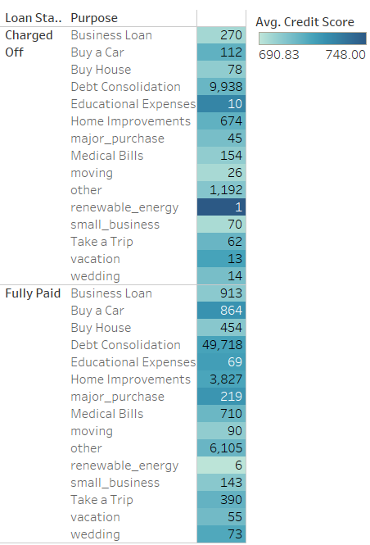
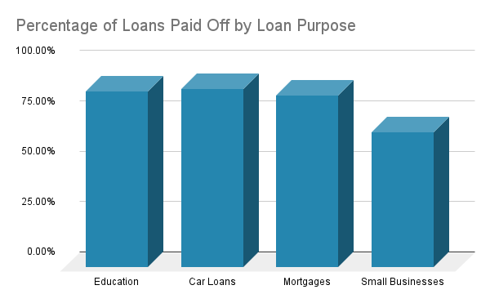
Status of Loan Based on Purpose
81.04% of loans from this dataset are fully paid
The lowest percentage of paid off loans are for small businesses
Notes:
Purposes with the highest percentage paid off are
education
car loans
mortgages
Least paid off are small businesses, as you can see in the graph compared to the highest.
Based on this data, lenders should be wary of loaning money for small businesses Education loans are the best to give because they are paid off at the highest rate

Slide 9
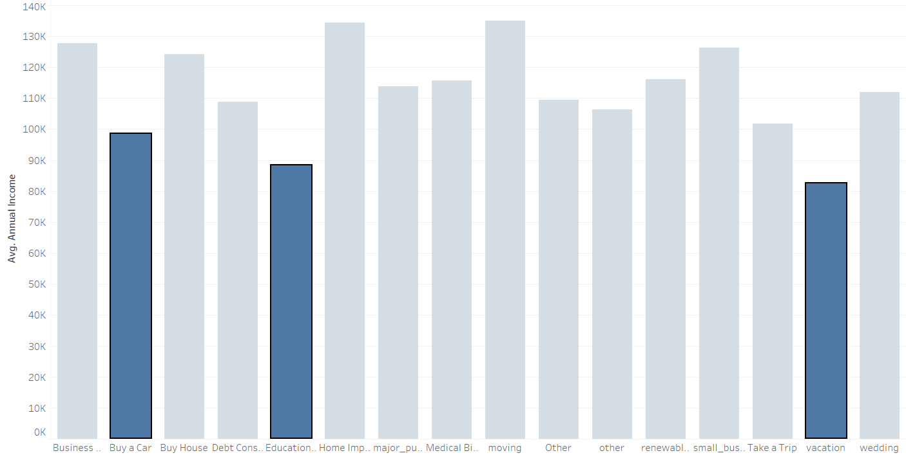
Purpose of Loan Based on Average Income
Highest and Lowest
Both moving and home improvement have the highest average annual incomes.
Education, buying a car, and vacations have the lowest.
This information can be used to market loans to the correct audiences.
Vacations
Borrowers that take loans for vacations have the lowest average income.
Notes:
Can market loans to users based on average income via online advertising

Slide 10
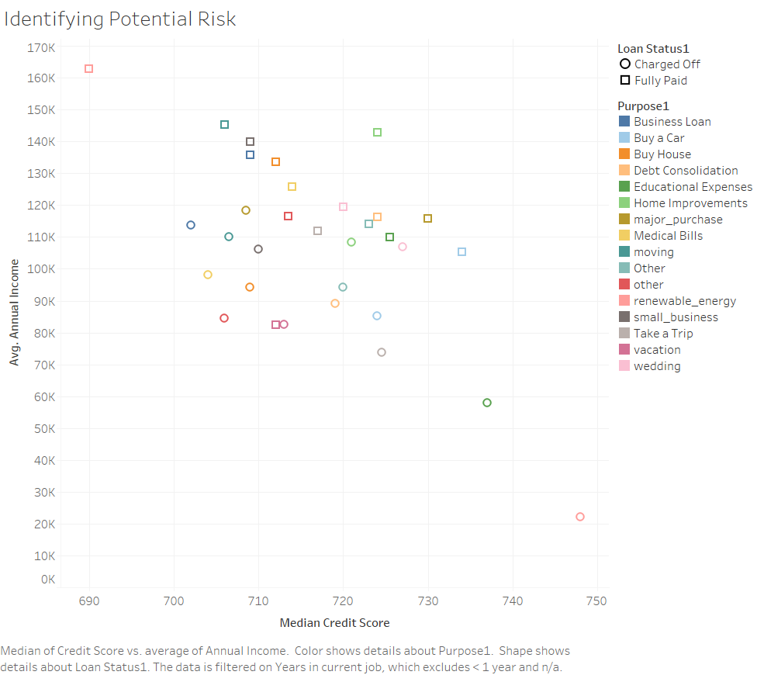
Identifying Potential Risk in Lending Purposes
The highest average income correlates with paid off loans for renewable energy, while the lowest average income correlates with charged off loans for renewable energy.
Renewable energy loans were an outlier in this comparison, making them a risky lending option due to having unpredictable results.

Slide 11
Summary
Recommendations for the credit union, based on the data analyses, are the following:
Strongly consider lending less for small businesses
Use data to market loans to the correct audience, for example targeting loans for home improvements to those with an household income of over $130k
Weigh the risks of lending for renewable energy, given it being an unpredictable ROI

Slide 12
THANK YOU
Any questions?
Connect with Me
in/joshmeldrum
joshuameldrum@yahoo.com

